Slide 1
Graduate School of Education
Multicultural Education
Week 6
Sample Lesson
Processing

Slide 2
Homework for Next Week
Research you presentation topic

Slide 3
Presentation Schedule
Time
Week 8
Oct 26
Week 9
Nov 2
Week 10
Nov 9
8:15-8:35
노송이
Int vs Ext
오제훈
Soc Roles
8:40-9:00
박슬기
Power D
김선영
D&I Comm
9:05-9:25

Slide 4
Rubric
Content & Accuracy 30%
Organization & Analysis 30%
Speaking (Volume & Rate) 10%
Pronunciation & Clarity 10%
Usage & Vocabulary 10%
Poise, Fluency, Naturalness 10%

Slide 5
Culture Project/Presentation
Define the term or concept
Describe it and provide examples
Analyze sources of misunderstanding/conflict
Make recommendation for how we can teach are raise student awareness of this aspect of culture based on the theory of teaching cultural such as the cultural knowing framework, etc… (p. 39-49).

Slide 6
Cultural Knowing Framework
Knowing about
Knowing how
Knowing why
Knowing oneself
These are the outcomes of activities in
The Cultural Experience
Notes:
‹#›

Slide 7
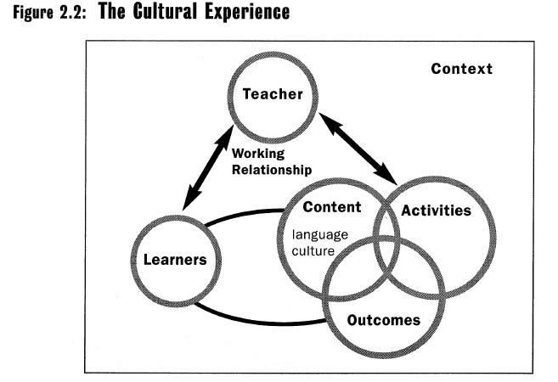
As I teach
Identify the content,
activities and outcomes

Slide 8
Warm-Up
What is cultural conflict?
Have you ever experienced cultural conflict?
If so, what happened? What was the problem?
If not, do you know anyone who has experienced cultural conflict? What happened? What was the problem?
Notes:
‹#›

Slide 9
Vocabulary
tension
figure out
aggressive
resolve
responsibility
collaboration
colleague
What do you think these words mean?
Discuss in groups.
Notes:
‹#›

Slide 10
Word Bank
tension
figure out
aggressive
resolve
responsibility
collaboration
colleague
Use these words
to complete the sentences.
Notes:
‹#›

Slide 11
Reading 1
Read and underline the problems
Notes:
‹#›

Slide 12
Reading 2
Read and fill in the chart
Notes:
‹#›

Slide 13
Make new groups
Share information with each other and complete the chart
  What does…say about…?
  … says …
Notes:
‹#›

Slide 14
Making Inferences
Work together to figure out who might have that expectation: (S)akiko or (E)dmundo.
Notes:
‹#›

Slide 15
Roles & Responsibilities
Vice President of Marketing – chairs the meeting and presents the groups opinion
Editor-in-Chief – note taker
Assistant director of human resources – draws action plan on poster paper
Notes:
‹#›

Slide 16
The Task:
Problem Solving Simulation
In your groups, discuss a possible solution to Sakiko and Edmundo’s problem.
Use the discussion questions to help you make an action plan.
Make sure that the action plan has both short term and long term solutions.
Notes:
‹#›

Slide 17
Group Discussion
Look at pages 111-121 in the coursebook and think about the following:
  What were the activities?
  Which focused on language & which on culture?
  What was the content for each activity?
  What aspect of the cultural knowing framework were Ss working with? (This is the outcome)
Use what you know about the cultural experience, the
cultural knowledge framework and the ELC

Slide 18
Think about your answers to the questions on the
last slide, how do they relate to this diagram?

Slide 19
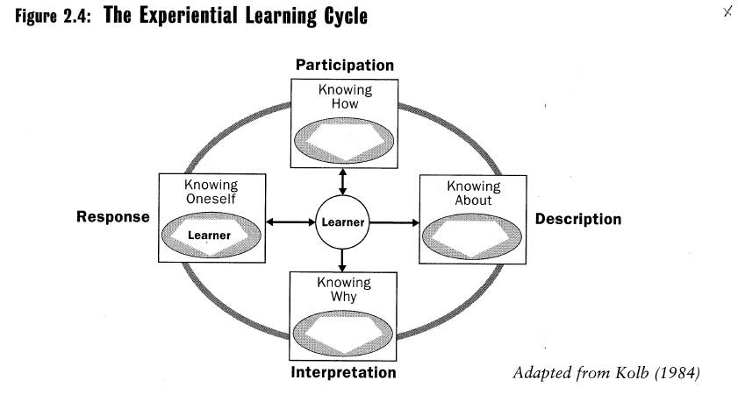
Does the lesson and materials fit with the ELC? If so how?

Slide 20
Teaching Culture
Teaching culture is really a lot like teaching language because language and culture are two sides of the same coin.
Understanding comes before production
Controlled production comes before use
Use the same techniques when considering how to teach your own cultural topic.

Slide 21
Immersion vs. EFL
The goal of an ESL immersion program is often to teach both the target language and the target culture
The goal of an EFL program should be focused on cultural awareness rather than enculturation

Slide 22
Sample Presentation

Slide 23
Cultural Awareness
How do we develop cultural awareness in our students? Do we begin by looking at other cultures or do we begin by looking at the learners’ own culture?
Why?

Slide 24
Language-and-Culture
Take and moment to brainstorm and outline your thoughts regarding:
  A problem you have had when speaking English that you believe was the result of culture and not a mistake of form, meaning or use?
Share this experience with your group members

Slide 25
Language-and-Culture
Language is a window to culture
  Example 1: tu and vous tells us that in French culture a clear distinction is made between formal and informal relationships and language helps to establish roles and maintain these relationships
  Example 2: 먹자 and 드세요 tells us that in Korean culture status of a speaker is important because different grammatical forms allows speakers to recognize people with higher or lower status

Slide 26
Language-and-Culture
In groups analyze your language-and-culture experiences: How is the language-and-culture problem you shared a window into the culture?

Slide 27
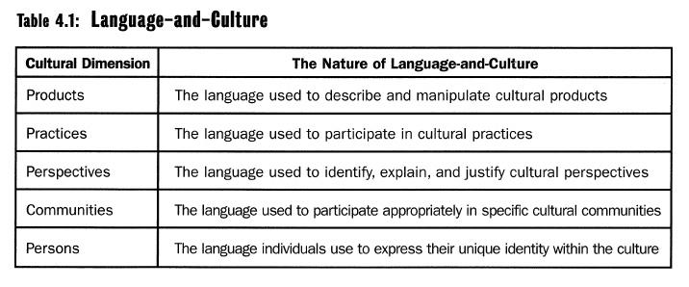
Language-and-Culture
in relationship to the 5 dimensions of culture

Slide 28
Language-and-Culture
When immersed in the culture itself, language-and-culture is “embedded” in the 5 dimensions of culture (products, practices, perspectives, communities and persons), so language-and-culture is best seen as joined
In the language classroom, we separate the two, because first Ss need the language so that they can describe, interpret and respond to the culture they are learning

Slide 29
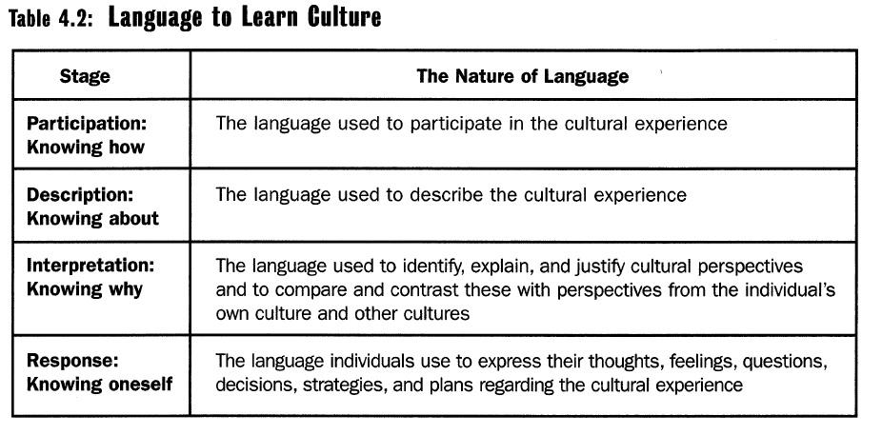
Language to Learn Culture

Slide 30
Language to Learn Culture
First Ss need the language that allow them to participate in some kind of cultural experience
  A trip to the mall
Second they need the language to describe the experience
  What happened at the mall
Third they need the language to analyze the experience
  How is this similar of different form my own culture? Why do they do this instead of that?
Fourth they need the language to respond to this experience
  How do I feel about these differences?

Slide 31
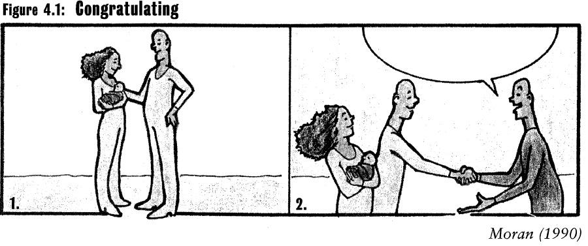
Use Korean. Write the dialog.
Compare your
dialog with your partner’s. What language
functions are involved?

Slide 32
Language to Learn Culture
The dialogs you wrote and analyzed are the language needed to be involved in this particular cultural experience. Before Ss can analyze Korean culture surrounding childbirth, they would need the language to participate in that experience.
After they have acquired the language of participation, they need to have the experience
After they have had the cultural experience they can start to better understand the culture through description, interpretation and response.

Slide 33
Describing-Interpreting-Responding to Culture
Each group will get a picture of some Korean cultural experience
In English use the language of Describing, Interpreting and Responding to culture to write about the picture
You will create a poster. The picture will be at the top center, the description will be on the center right, the interpretation will be on the bottom center, and the response will be on the center left.

Slide 34
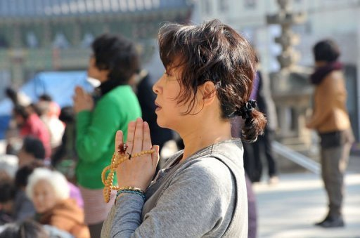
Korean parents pray for success of their children in the KSAT

Slide 35
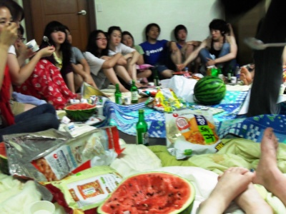
Korean college student participate in their club’s membership training

Slide 36
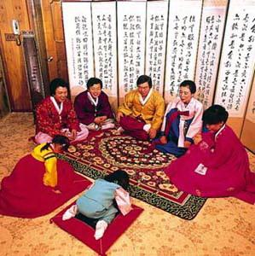
Korean children bow to their elders during Lunar New Years

Slide 37
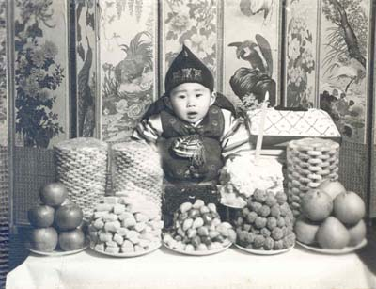
100 day birthday party Korea

